Slide 1


Session One
Eternity Past – God
Father, Son, Holy Spirit

Slide 2
A little background…
The first book I read was the Bible – 1969
But I wanted to be a scientist
I was called into ministry in 1981
This was a supernatural call…
Since then, I have only studied the Bible
  and we are about to embark
  on an epic journey through
  the whole Bible!

Slide 3

This adventure is 43 years in the making as God has spoken to me regarding His Word!
And 31 years at a scholarly level…

Slide 4
We will not only study the Bible, but history, archeology, anthropology, theology, science, sociology, and philosophy as well.

Slide 5
For this journey, I will be simply be your guide as we go through what God has revealed to us in scripture. This has been a lifetime in the making…

Slide 6
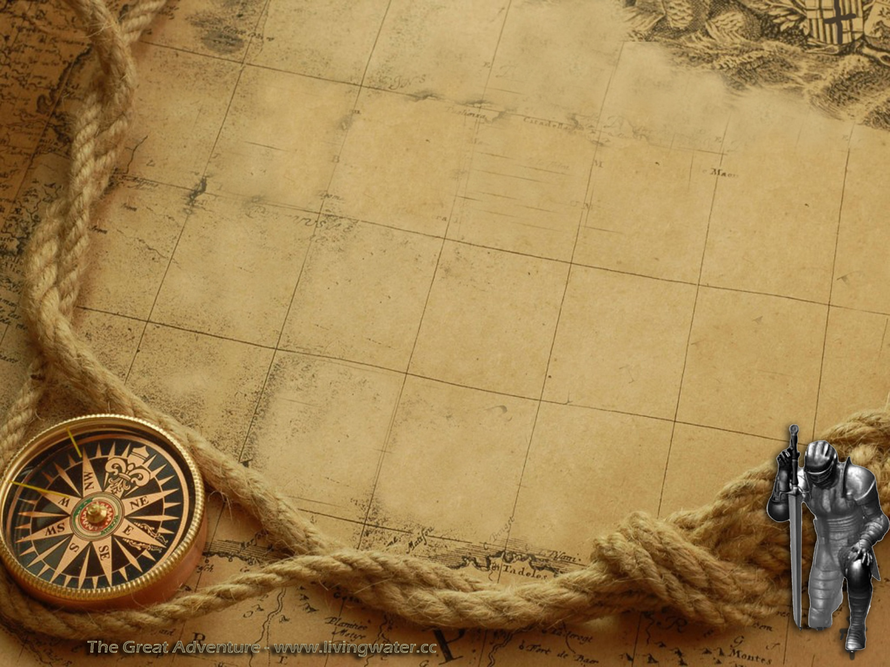
The Great Adventure @ Living Water!
From Eternity past to Eternity future…
From Before Genesis to Revelation
in chronological order!
This will be an exciting journey through the Bible as we travel through time and scripture and study the events as they occurred in historical sequence!
Everyone who stays with us for the whole journey will receive a Bachelors degree from Coastland University in Biblical Studies!

Slide 7
Where we are headed…
Week 1: God before anything else – eternity past and the Trinity
Week 2: The dwelling place of God in eternity past – the 3rd heaven
Week 3: The creation of angels and their purpose before Genesis 1
Week 4: Genesis 1:1-2 – the initial creation and the fall of Satan
Week 5: The creation of the universe & world as we know it

Slide 9
The beginning…or is it?
Gen 1:1 In the beginning God created the heavens and the earth.
Joh 1:1-3 In the beginning was the Word, and the Word was with God, and the Word was God. 2 He was in the beginning with God. 3 All things came into being through Him, and apart from Him nothing came into being that has come into being.

Slide 10
Heb 1:10 And, "YOU, LORD, IN THE BEGINNING LAID THE FOUNDATION OF THE EARTH, AND THE HEAVENS ARE THE WORKS OF YOUR HANDS;
Heb 1:11 THEY WILL PERISH, BUT YOU REMAIN; AND THEY ALL WILL BECOME OLD LIKE A GARMENT,
Heb 1:12 AND LIKE A MANTLE YOU WILL ROLL THEM UP; LIKE A GARMENT THEY WILL ALSO BE CHANGED. BUT YOU ARE THE SAME, AND YOUR YEARS WILL NOT COME TO AN END."

Slide 11
Beginning
God, consisting of the Father, the Son, and the Holy Spirit always existed from eternity past – but at some point in the vast expanse of time, God created the heavens (1&2), and the earth, so the ‘beginning’ is actually the beginning of creation as we know it, not the beginning of God, for He always was…

Slide 12
Before anything, there was God
Psa 90:2 Before the mountains were born Or You gave birth to the earth and the world, Even from everlasting to everlasting, You are God.
So the first question is who is God?

Slide 13
Psa 102:25 "Of old You founded the earth, And the heavens are the work of Your hands.
Psa 102:26 "Even they will perish, but You endure; And all of them will wear out like a garment; Like clothing You will change them and they will be changed.
Psa 102:27 "But You are the same, And Your years will not come to an end.

Slide 14
Heb 13:8 Jesus Christ is the same yesterday and today and forever.
Heb 13:9 Do not be carried away by varied and strange teachings; for it is good for the heart to be strengthened by grace, not by foods, through which those who were so occupied were not benefited.

Slide 15
Isa 43:10 "You are My witnesses," declares the LORD, "And My servant whom I have chosen, So that you may know and believe Me And understand that I am He. Before Me there was no God formed, And there will be none after Me.
Isa 43:11 "I, even I, am the LORD, And there is no savior besides Me.
Isa 43:12 "It is I who have declared and saved and proclaimed, And there was no strange god among you; So you are My witnesses," declares the LORD, "And I am God.
Isa 43:13 "Even from eternity I am He, And there is none who can deliver out of My hand; I act and who can reverse it?"
Isa 43:14 Thus says the LORD your Redeemer, the Holy One of Israel

Slide 16
Joh 8:56 "Your father Abraham rejoiced to see My day, and he saw it and was glad."
Joh 8:57 So the Jews said to Him, "You are not yet fifty years old, and have You seen Abraham?"
Joh 8:58 Jesus said to them, "Truly, truly, I say to you, before Abraham was born, I am."

Slide 17
God always existed
God = Father, Son, & Holy Spirit
Most often the Father is called God
Jesus is called Lord, Christ (Messiah), Savior
The Holy Spirit is always called just that

Slide 18
Jesus was there with God!
Joh 17:5 "Now, Father, glorify Me together with Yourself, with the glory which I had with You before the world was.
God loved Jesus before it all…
Joh 17:24 "Father, I desire that they also, whom You have given Me, be with Me where I am, so that they may see My glory which You have given Me, for You loved Me before the foundation of the world.

Slide 19
Jesus in eternity…
Mic 5:2 "But as for you, Bethlehem Ephrathah, Too little to be among the clans of Judah, From you One will go forth for Me to be ruler in Israel. His goings forth are from long ago, From the days of eternity."

Slide 20
The Spirit is eternal as well…
Heb 9:14 how much more will the blood of Christ, who through the eternal Spirit offered Himself without blemish to God, cleanse your conscience from dead works to serve the living God?

Slide 21
“It is evident, by both Scripture and reason, that God is infinitely, eternally, unchangeably, and independently glorious and happy.” Jonathan Edwards
From eternity past, God was full of joy in His glory, fully content as the three persons of the trinity had complete fellowship.

Slide 22
Act 17:24 "The God who made the world and all things in it, since He is Lord of heaven and earth, does not dwell in temples made with hands;
Act 17:25 nor is He served by human hands, as though He needed anything, since He Himself gives to all people life and breath and all things;

Slide 23
So, before anything, there was the tri-une God; Father, Son, and Holy Spirit & the 3rd heaven or the throne of God…
Before we can continue, we need to look at who God is and where they were before creation – the eternal trinity or Godhead.

Slide 24
They conversed with one another:
Gen 1:26 Then God(s) said, "Let Us make man in Our image, according to Our likeness;
We must gaze at the Trinity because that is what always has been – before creation…

Slide 25
We have been taught the trinity can’t be understood.
I suggest to you that God, revealed to us in scripture exactly what the trinity looks like.
Let us gaze upon the sacred text of scripture and understand the three persons of the Triune Godhead.

Slide 26
God wants us to get to know Him
Romans 1:20 “For since the creation of the world God's invisible qualities — His eternal power and divine nature — have been clearly seen, being understood from what has been made, so that men are without excuse.”

Slide 27
Jeremiah 9:24-24
  “This is what the LORD says: “Let not the wise man boast of his wisdom or the strong man boast of his strength or the rich man boast of his riches, 24 but let him who boasts boast about this: that he understands and knows me, that I am the LORD, who exercises kindness, justice and righteousness on earth, for in these I delight,” declares the LORD.

Slide 28
We need to know all three persons of the Godhead
John 17:3 “This is eternal life, that they may know You, the only true God, and Jesus Christ whom You have sent.”
Joh 14:16 "I will ask the Father, and He will give you another Helper, that He may be with you forever; 17 that is the Spirit of truth, whom the world cannot receive, because it does not see Him or know Him, but you know Him because He abides with you and will be in you.

Slide 29
THE TRINITY
Here is the classical definition:
God eternally exists as three persons, Father, Son, and Holy Spirit, and each person is fully God, and that the three make up one Godhead.

Slide 30
THE TRINITY
1. God is three persons.
2. Each person is fully God.
3. There is one Godhead.
An early diagram of the trinity…

Slide 31
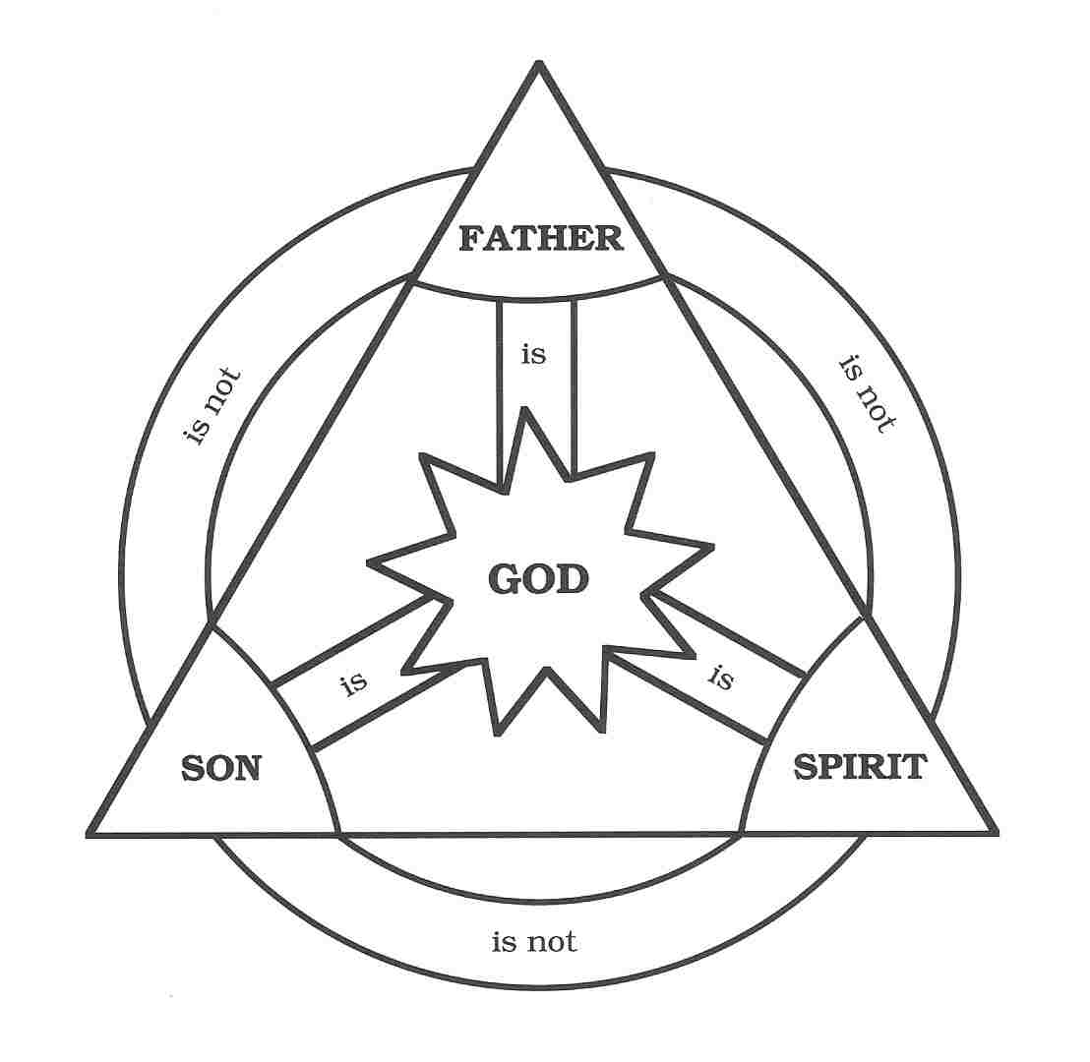
Elohiem – God’s

Slide 32
Three persons with unique personality, functions, and spatially separate individuals but fully operating as one.
So, here in is the confusion – utilizing expositional consistency, what does ‘one’ mean? – It is a singular plurality…

Slide 33
Three persons, one God
John 10:30 "I and the Father are one."
One = full agreement, together, same in purpose
Mar 10:7 "FOR THIS REASON A MAN SHALL LEAVE HIS FATHER AND MOTHER,
Mar 10:8 AND THE TWO SHALL BECOME ONE FLESH; so they are no longer two, but one flesh.

Slide 34
The Church is many but one…
Joh 17:11 "I am no longer in the world; and yet they themselves are in the world, and I come to You. Holy Father, keep them in Your name, the name which You have given Me, that they may be one even as We are.

Slide 35
Joh 17:22 "The glory which You have given Me I have given to them, that they may be one, just as We are one;
Again, the definition is full agreement, together with like purpose, unified, thus the term ‘trinity’ or tri-unity.

Slide 36
God is not one person
But three person’s in full agreement, unity, and togetherness in purpose and thought.
Just like a man and woman in marriage should be.
Just like the true church should be.

Slide 37
1. God Is Three Persons.
God is not one person that wears three hats.
Passages showing distinctions.
John 1:1-2 tells us: “In the beginning was the Word, and the Word was with God, and the Word was God. He was in the beginning with God.”
The fact that the “Word” (who is seen to be Christ in vv. 9-18) is “with” God shows distinction from God the Father.

Slide 38
In John 17:24 (NIV), Jesus speaks to God the Father about “my glory, the glory you have given me because you loved me before the creation of the world,” thus showing distinction of persons, sharing of glory, and a relationship of love between the Father and the Son before the world was created.
Jesus continues as our High Priest and Advocate before God the Father:

Slide 39
We are told to pray to the Father through Jesus:
Mat 6:9 "Pray, then, in this way: 'Our Father who is in heaven, Hallowed be Your name.
In Jesus name:
Joh 14:13 "Whatever you ask in My name, that will I do, so that the Father may be glorified in the Son.

Slide 40
Romans 8:34
“Who is the one who condemns? Christ Jesus is He who died, yes, rather who was raised, who is at the right hand of God, who also intercedes for us”
What about the Holy Spirit?

Slide 41
Jesus says, “But the Counselor, the Holy Spirit, whom the Father will send in my name, he will teach you all things, and bring to your remembrance all that I have said to you” (John 14:26).
The Holy Spirit also prays or “intercedes” for us (Rom. 8:27), indicating a distinction between the Holy Spirit and God the Father to whom the intercession is made.

Slide 42
Some have questioned whether the Holy Spirit is indeed a distinct person, rather than just the "power" or "force" of God
First the Holy Spirit is put in a coordinate relationship with the Father and the Son (Matt. 28:19; 1 Cor. 12:4-6; 2 Cor. 13:14; Eph. 4:4-6; 1 Peter 1:2)

Slide 43
3 persons with separate spatial existence…
Luke 3:21-22
“Now when all the people were baptized, Jesus was also baptized, and while He was praying, heaven was opened, and the Holy Spirit descended upon Him in bodily form, like a dove, and a voice came out of heaven, “You are My beloved Son, in You I am well pleased”

Slide 44
Some observations
No one member of the Trinity is any “better,” “stronger,” or “greater” than the other two – yet there is a voluntary structure and hierarchy (I Cor.11 plus)
The relationship between the Trinity is eternal in nature - it always was, it always will be
The Son is eternally subordinate to the Father, yet the Father will give full reign to the Son for the Millennial reign (Dan.7).
The Spirit is subordinate to the Father and the Son, yet He is the only member of the Trinity we can not blaspheme! (Matt. 12:31)

Slide 45
The Holy Spirit is without form and is everywhere.
Psa 139:7 Where can I go from Your Spirit? Or where can I flee from Your presence? 8 If I ascend to heaven, You are there; If I make my bed in Sheol, behold, You are there. 9 If I take the wings of the dawn, If I dwell in the remotest part of the sea, 10 Even there Your hand will lead me, And Your right hand will lay hold of me.
Notes:
45

Slide 46
God is omnipresent through the agency of the Holy Spirit. Where is Jesus today?
Col 3:1 Therefore if you have been raised up with Christ, keep seeking the things above, where Christ is, seated at the right hand of God(the Father).
Notes:
46

Slide 47
The Father
Rev 4:2 Immediately I was in the Spirit; and behold, a throne was standing in heaven, and One sitting on the throne.
Rev 4:3 And He who was sitting was like a jasper stone and a sardius in appearance; and there was a rainbow around the throne, like an emerald in appearance.

Slide 48
Rev 2:1 "To the angel of the church in Ephesus write: The One who holds the seven stars in His right hand, the One who walks among the seven golden lampstands, says this:

Slide 49
So, we have God the Father on the throne, Jesus at the right hand of the Father in the midst of the seven lampstands, with 24 elders around the throne and four living creatures around the throne…

Slide 50
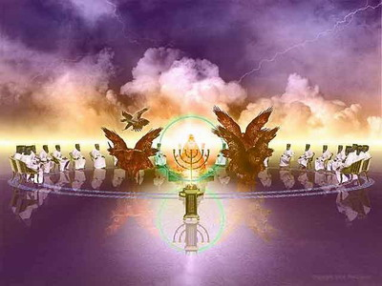
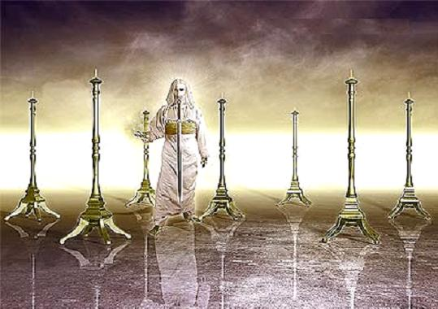

Slide 51
Rev 5:1 I saw in the right hand of Him who sat on the throne a book written inside and on the back, sealed up with seven seals.
Jesus …
Rev 5:6 And I saw between the throne (with the four living creatures) and the elders a Lamb standing, as if slain, having seven horns and seven eyes, which are the seven Spirits of God, sent out into all the earth.
Rev 5:7 And He came and took the book out of the right hand of Him who sat on the throne.

Slide 52
1Ti 1:16 Yet for this reason I found mercy, so that in me as the foremost, Jesus Christ might demonstrate His perfect patience as an example for those who would believe in Him for eternal life.
1Ti 1:17 Now to the King eternal, immortal, invisible, the only God, be honor and glory forever and ever. Amen.

Slide 53
2Co 4:16 Therefore we do not lose heart, but though our outer man is decaying, yet our inner man is being renewed day by day.
2Co 4:17 For momentary, light affliction is producing for us an eternal weight of glory far beyond all comparison,
2Co 4:18 while we look not at the things which are seen, but at the things which are not seen; for the things which are seen are temporal, but the things which are not seen are eternal.

Slide 54
The Bible tells us both the Father and the son can be seen
Exo 6:2 God spoke further to Moses and said to him, "I am the LORD;
Exo 6:3 and I appeared to Abraham, Isaac, and Jacob, as God Almighty, but by My name, LORD, I did not make Myself known to them.
Exo 6:4 "I also established My covenant with them, to give them the land of Canaan, the land in which they sojourned.

Slide 55
My call into ministry
When I was called into ministry, I did not want to heed the call
I was caught up to heaven – the dwelling place and throne room of God
I saw the throne, and paced before the Father and the Son!

Slide 56
The Father is on the throne, and Jesus is at the literal right hand of the Father!
Rev 5:6 And I saw between the throne (with the four living creatures) and the elders a Lamb standing, as if slain, having seven horns and seven eyes, which are the seven Spirits of God, sent out into all the earth.
Rev 5:7 And He came and took the book out of the right hand of Him who sat on the throne.
The Father and the Son have physical form!

Slide 57
Gen 1:26 Then God said, "Let Us make man in Our image, according to Our likeness; and let them rule over the fish of the sea and over the birds of the sky and over the cattle and over all the earth, and over every creeping thing that creeps on the earth.“ 27 God created man in His own image, in the image of God He created him; male and female He created them.
Notes:
57

Slide 58
Image – “A masculine noun meaning an image, a likeness, a statue, a model, a drawing, a shadow”
Likeness – “A feminine noun meaning resemblance; concrete model, shape”
The Hebrew is very clear here – we are made in the physical likeness of The Father and the Son!
Notes:
58

Slide 59
Angels are the likeness of God as well…
Dan 10:16 And behold, one in the likeness of the children of man touched my lips. Then I opened my mouth and spoke. I said to him who stood before me, "O my lord, by reason of the vision pains have come upon me, and I retain no strength.
Notes:
59

Slide 60
Gen 5:1 This is the book of the generations of Adam. When God created man, he made him in the likeness of God.
Gen 5:3 When Adam had lived 130 years, he fathered a son in his own likeness, after his image, and named him Seth.
Notes:
60

Slide 61
Gen 5:3 When Adam had lived 130 years, he fathered a son in his own likeness, after his image, and named him Seth.
Gen 1:26 Then God said, "Let Us make man in Our image, according to Our likeness;
Same words!!!!
Notes:
61

Slide 62
No man can see God and live, yet men have seen God and we will see God!
Mat 5:8 "Blessed are the pure in heart, for they shall see God. “

Slide 63
Abram saw God: "When Abram was ninety-nine years old, the Lord appeared to him and said, "I am God Almighty; walk before me and be blameless." (Gen. 17:1)
Jacob saw God: "It is because I saw God face to face, and yet my life was spared." (Gen. 32:30)

Slide 64
The leaders of Israel saw God: "But God did not raise his hand against these leaders of the Israelites; they saw God, and they ate and drank." (Exod. 24:11)

Slide 65
Some say God is an energy cloud with no form…
Joh 4:24 "God is spirit, and those who worship Him must worship in spirit and truth."
So are we!
Joh 3:6 "That which is born of the flesh is flesh, and that which is born of the Spirit is spirit. 7 "Do not be amazed that I said to you, 'You must be born again.‘ 8 "The wind blows where it wishes and you hear the sound of it, but do not know where it comes from and where it is going; so is everyone who is born of the Spirit."

Slide 66
So are angels!
Heb 1:13 But to which of the angels has He ever said, "SIT AT MY RIGHT HAND, UNTIL I MAKE YOUR ENEMIES A FOOTSTOOL FOR YOUR FEET"?
Heb 1:14 Are they not all ministering spirits, sent out to render service for the sake of those who will inherit salvation?
Yet they have bodies and appearance! As do we!

Slide 67
Can’t see God?
3Jn 1:11 Beloved, do not imitate what is evil, but what is good. The one who does good is of God; the one who does evil has not seen God.

Slide 68
Seen – to fully understand and discern clearly.
YES! No one can fully understand and discern God the Father clearly!!!
Only the Spirit of God can do that!

Slide 69
1Co 2:9 but just as it is written, "THINGS WHICH EYE HAS NOT SEEN AND EAR HAS NOT HEARD, AND which HAVE NOT ENTERED THE HEART OF MAN, ALL THAT GOD HAS PREPARED FOR THOSE WHO LOVE HIM."
1Co 2:10 For to us God revealed them through the Spirit; for the Spirit searches all things, even the depths of God.
1Co 2:11 For who among men knows the thoughts of a man except the spirit of the man which is in him? Even so the thoughts of God no one knows except the Spirit of God.

Slide 70
Psa 73:1 A Psalm of Asaph. Surely God is good to Israel, To those who are pure in heart!
Mat 5:8 "Blessed are the pure in heart, for they shall see God.

Slide 71
Stephen Saw God
Act 7:55 But being full of the Holy Spirit, he gazed intently into heaven and saw the glory of God, and Jesus standing at the right hand of God;
Act 7:56 and he said, "Behold, I see the heavens opened up and the Son of Man standing at the right hand of God."

Slide 72
LORD – Yaweh – God the Father!
Exo 33:11 Thus the LORD used to speak to Moses face to face, just as a man speaks to his friend. When Moses returned to the camp, his servant Joshua, the son of Nun, a young man, would not depart from the tent.

Slide 73
Deu 5:2 "The LORD our God made a covenant with us at Horeb.
Deu 5:3 "The LORD did not make this covenant with our fathers, but with us, with all those of us alive here today.
Deu 5:4 "The LORD spoke to you face to face at the mountain from the midst of the fire,
Deu 5:5 while I was standing between the LORD and you at that time, to declare to you the word of the LORD; for you were afraid because of the fire and did not go up the mountain. He said,
Deu 5:6 'I am the LORD your God who brought you out of the land of Egypt, out of the house of slavery.
Deu 5:7 'You shall have no other gods before Me.

Slide 74
Exo 33:11 Thus the LORD used to speak to Moses face to face, just as a man speaks to his friend. When Moses returned to the camp, his servant Joshua, the son of Nun, a young man, would not depart from the tent.

Slide 75
Eze 20:33 "As I live," declares the Lord GOD, "surely with a mighty hand and with an outstretched arm and with wrath poured out, I shall be king over you. 34 "I will bring you out from the peoples and gather you from the lands where you are scattered, with a mighty hand and with an outstretched arm and with wrath poured out; 35 and I will bring you into the wilderness of the peoples, and there I will enter into judgment with you face to face.
Eze 20:36 "As I entered into judgment with your fathers in the wilderness of the land of Egypt, so I will enter into judgment with you," declares the Lord GOD.

Slide 76
We will see God face to face!!!
Rev 22:1 Then he showed me a river of the water of life, clear as crystal, coming from the throne of God and of the Lamb,
Rev 22:2 in the middle of its street. On either side of the river was the tree of life, bearing twelve kinds of fruit, yielding its fruit every month; and the leaves of the tree were for the healing of the nations.

Slide 77
Rev 22:3 There will no longer be any curse; and the throne of God and of the Lamb will be in it, and His bond-servants will serve Him; 4 they will see His face, and His name will be on their foreheads.
Rev 3:11 'I am coming quickly; hold fast what you have, so that no one will take your crown. Rev 3:12 'He who overcomes, I will make him a pillar in the temple of My God, and he will not go out from it anymore; and I will write on him the name of My God,

Slide 78
1Jn 3:1 See how great a love the Father has bestowed on us, that we would be called children of God; and such we are. For this reason the world does not know us, because it did not know Him. 2 Beloved, now we are children of God, and it has not appeared as yet what we will be. We know that when He appears, we will be like Him, because we will see Him just as He is. 3 And everyone who has this hope fixed on Him purifies himself, just as He is pure.

Slide 79
Where is God the Father?
Rev 7:15 "For this reason, they are before the throne of God; and they serve Him day and night in His temple; and He who sits on the throne will spread His tabernacle over them.
Notes:
79

Slide 80
Dan 7:9 "I kept looking Until thrones were set up, And the Ancient of Days took His seat; His vesture was like white snow And the hair of His head like pure wool. His throne was ablaze with flames, Its wheels were a burning fire.
This is the Father, seated on His Throne
Notes:
80

Slide 81
Dan 7:10 "A river of fire was flowing And coming out from before Him; Thousands upon thousands were attending Him, And myriads upon myriads were standing before Him; The court sat, And the books were opened.
Notes:
81

Slide 82
Dan 7:13 "I kept looking in the night visions, And behold, with the clouds of heaven One like a Son of Man was coming, And He came up to the Ancient of Days And was presented before Him.
Notes:
82

Slide 83
Dan 7:14 "And to Him was given dominion, Glory and a kingdom, That all the peoples, nations and men of every language Might serve Him. His dominion is an everlasting dominion Which will not pass away; And His kingdom is one Which will not be destroyed.
Notes:
83

Slide 84
Rev 19:4 And the twenty-four elders and the four living creatures fell down and worshiped God who was seated on the throne, saying, "Amen. Hallelujah!"
Notes:
84

Slide 85
Rev 7:10 and crying out with a loud voice, "Salvation belongs to our God who sits on the throne, and to the Lamb!"
Notes:
85

Slide 86
What does the Father look like?
Let’s ‘see’…
Notes:
86

Slide 87
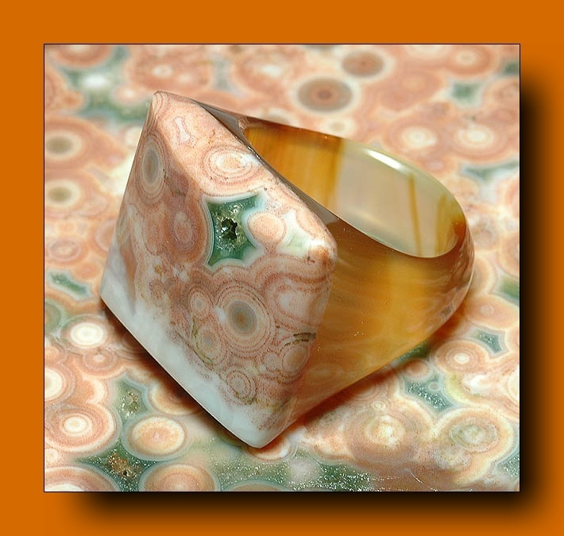
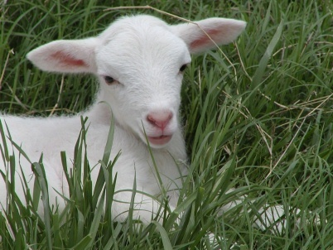
Rev 4:2 At once I was in the Spirit, and behold, a throne stood in heaven, with one seated on the throne.
Rev 4:3 And he who sat there had the appearance of jasper and carnelian, and around the throne was a rainbow that had the appearance of an emerald.
Dan 7:9 As I looked, thrones were placed, and the Ancient of days took his seat; his clothing was white as snow, and the hair of his head like pure wool;
Notes:
87

Slide 88
Jesus looks like the Father
Rev 1:12 Then I turned to see the voice that was speaking to me, and on turning I saw seven golden lampstands, 13 and in the midst of the lampstands one like a son of man, clothed with a long robe and with a golden sash around his chest. 14 The hairs of his head were white like wool, as white as snow. His eyes were like a flame of fire, 15 his feet were like burnished bronze, refined in a furnace, and his voice was like the roar of many waters.
Notes:
88

Slide 89
Joh 14:8 Philip *said to Him, "Lord, show us the Father, and it is enough for us."
Joh 14:9 Jesus *said to him, "Have I been so long with you, and yet you have not come to know Me, Philip? He who has seen Me has seen the Father; how can you say, 'Show us the Father'?
Joh 14:10 "Do you not believe that I am in the Father, and the Father is in Me? The words that I say to you I do not speak on My own initiative, but the Father abiding in Me does His works.
Joh 14:11 "Believe Me that I am in the Father and the Father is in Me; otherwise believe because of the works themselves.
Joh 14:12 "Truly, truly, I say to you, he who believes in Me, the works that I do, he will do also; and greater works than these he will do; because I go to the Father

Slide 90
Joh 17:20 "I do not ask on behalf of these alone, but for those also who believe in Me through their word;
Joh 17:21 that they may all be one; even as You, Father, are in Me and I in You, that they also may be in Us, so that the world may believe that You sent Me.
Joh 17:22 "The glory which You have given Me I have given to them, that they may be one, just as We are one;
Joh 17:23 I in them and You in Me, that they may be perfected in unity, so that the world may know that You sent Me, and loved them, even as You have loved Me.
Jesus is right now at the right hand of the Father, and they are both in us through the infilling of the Holy Spirit!

Slide 91
Rev 5:6 And between the throne and the four living creatures and among the elders I saw a Lamb standing, as though it had been slain, with seven horns and with seven eyes, which are the seven spirits of God sent out into all the earth.
Rev 5:7 And he went and took the scroll from the right hand of him who was seated on the throne.
Notes:
91

Slide 92
Rev 5:13 And I heard every creature in heaven and on earth and under the earth and in the sea, and all that is in them, saying, "To him who sits on the throne and to the Lamb be blessing and honor and glory and might forever and ever!"
Notes:
92

Slide 93
Hierarchy
1Co 11:3 But I want you to understand that Christ is the head of every man, and the man is the head of a woman, and God(Father) is the head of Christ.

Slide 94
Let us fix our eyes on Jesus, the author and perfecter of our faith, who for the joy set before Him endured the cross, scorning its shame, and sat down at the right hand of the throne of God.
Hebrews 12:1, 2 (NIV)

Slide 95
Colossians 3:1-4
“Therefore if you have been raised up with Christ, keep seeking the things above, where Christ is, seated at the right hand of God. Set your mind on the things above, not on the things that are on earth. For you have died and your life is hidden with Christ in God. When Christ, who is our life, is revealed, then you also will be revealed with Him in glory. "

Slide 96
What are the ‘things above’?
Next week we will discover this is the dwelling place of God from eternity past…
We call it ‘heaven’.

